Slide 1
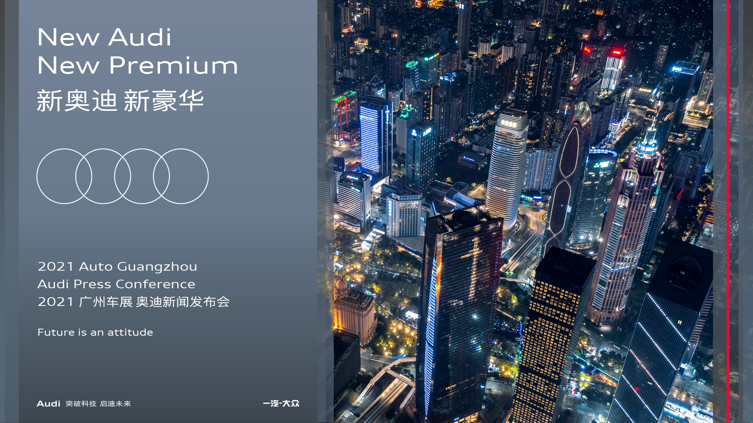
the theme in English
TBD
Key Visual

Slide 2

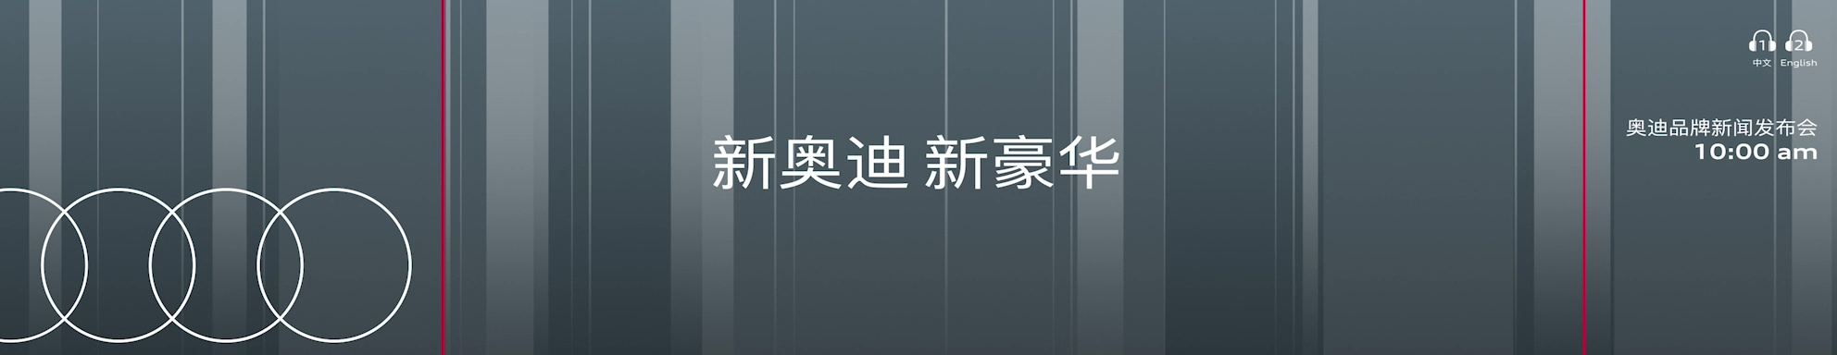
Welcome Loop
the theme in English TBD

Slide 3
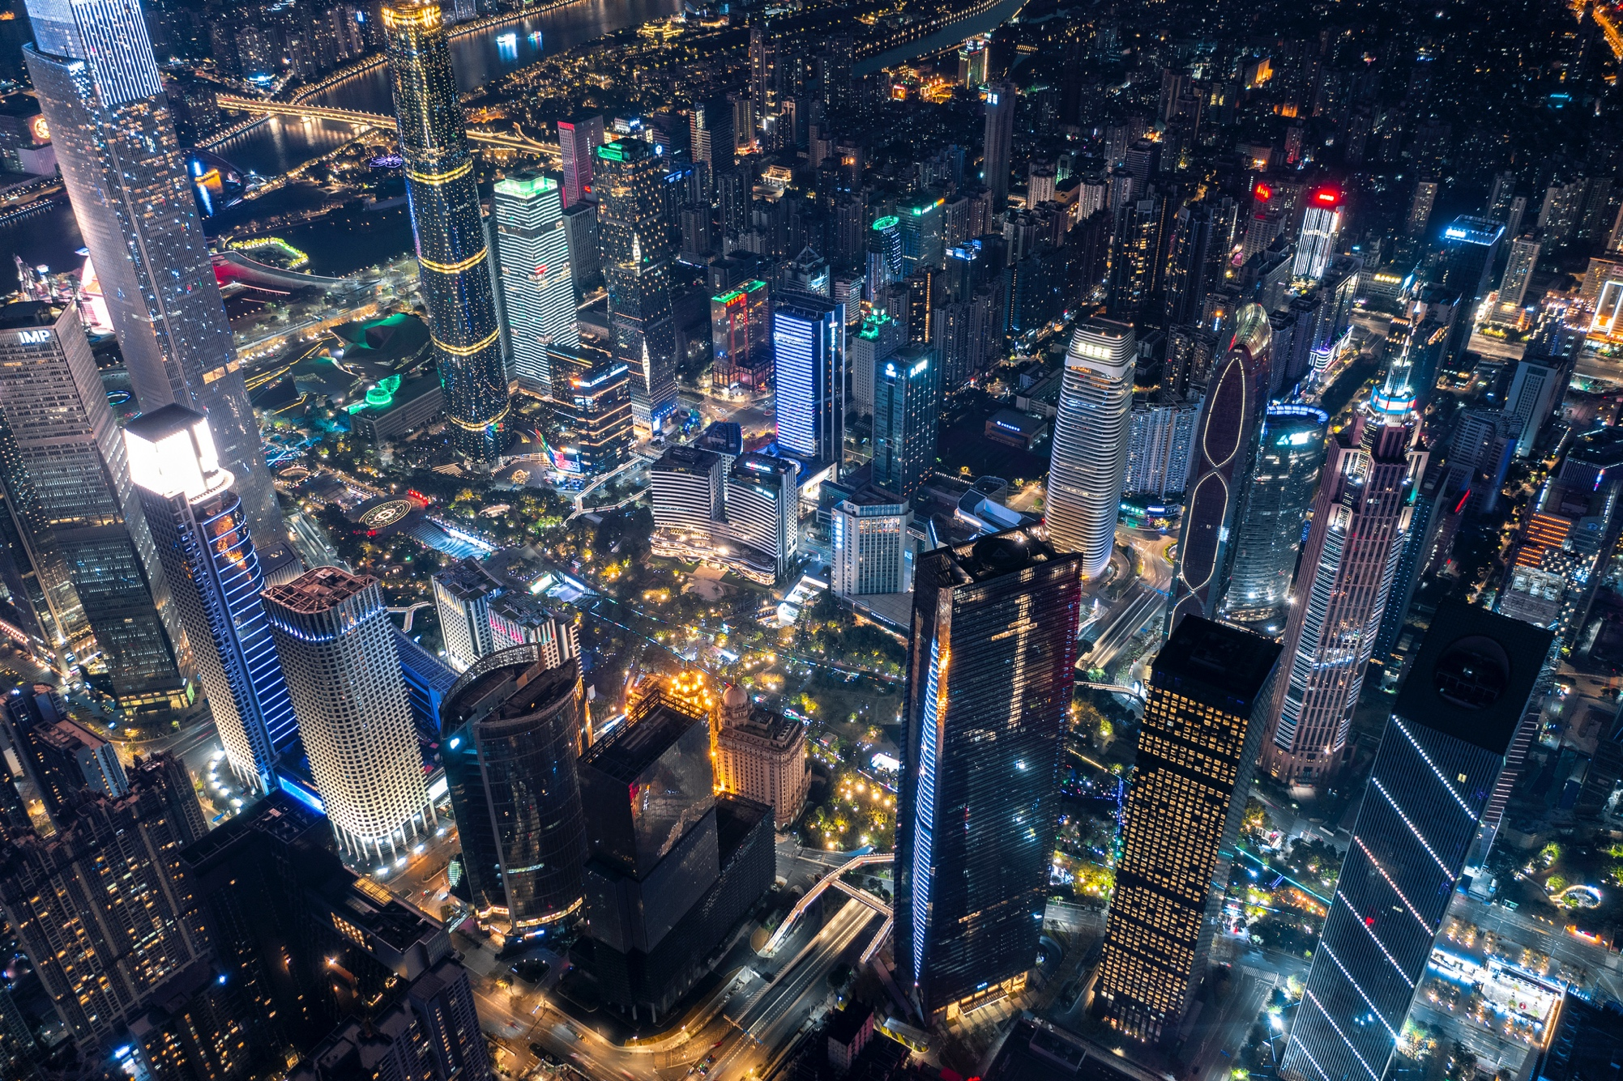
Opening Video
‚Future is an Attitude‘
the theme in English TBD

Slide 4


Opening Video ‚Future is an Attitude‘ (1:10 min)
the theme in English TBD

Slide 5

Opening Video ‚Future is an Attitude‘ (1:10 min)
Work in progress
towards this fascinating future.
Sneak Preview on A8L Horch & Q4 e-tron
the theme in English TBD

Slide 6
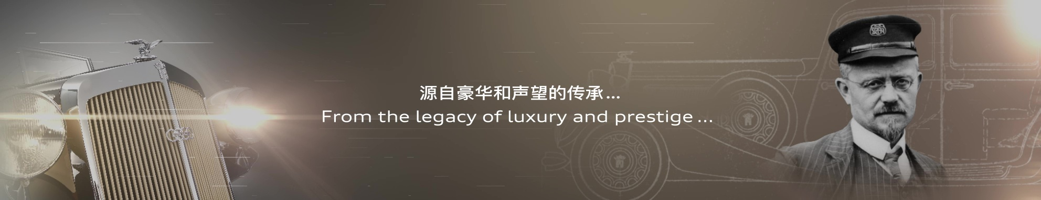
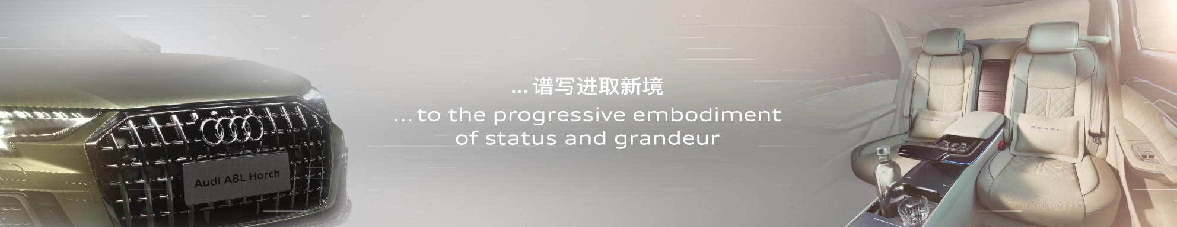
Media Show A8L Horch (45 sec)
The ellipsis in Chinese can be deleted.
The use of ellipsis in English needs to be evaluated.

Slide 7
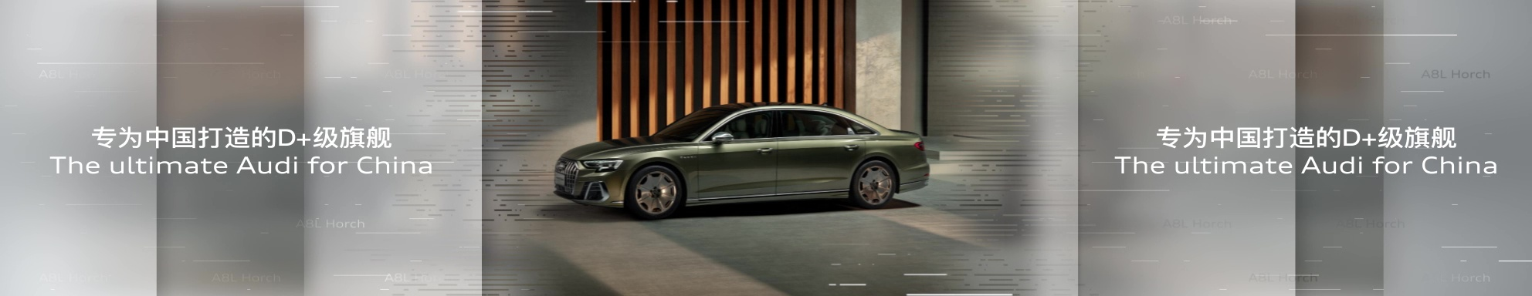
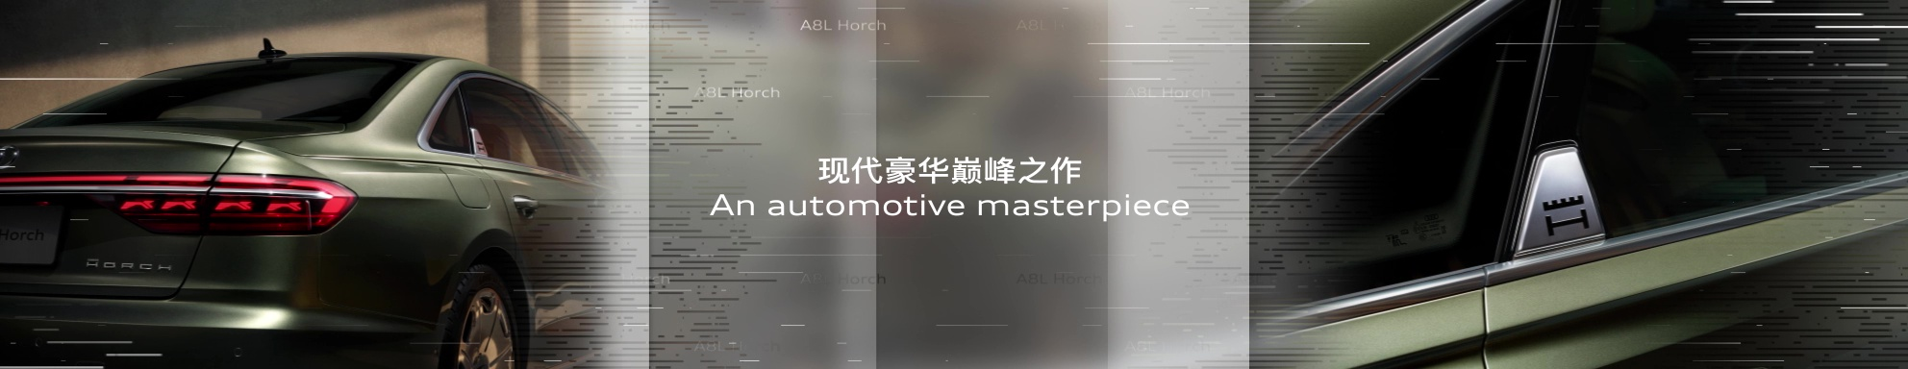
Media Show A8L Horch (45 sec)
Both Chinese and English subtitle replace:
奥迪品牌首款D+级豪华旗舰
The untimate D+ Audi/The untimate Audi of D+ segment

Slide 8
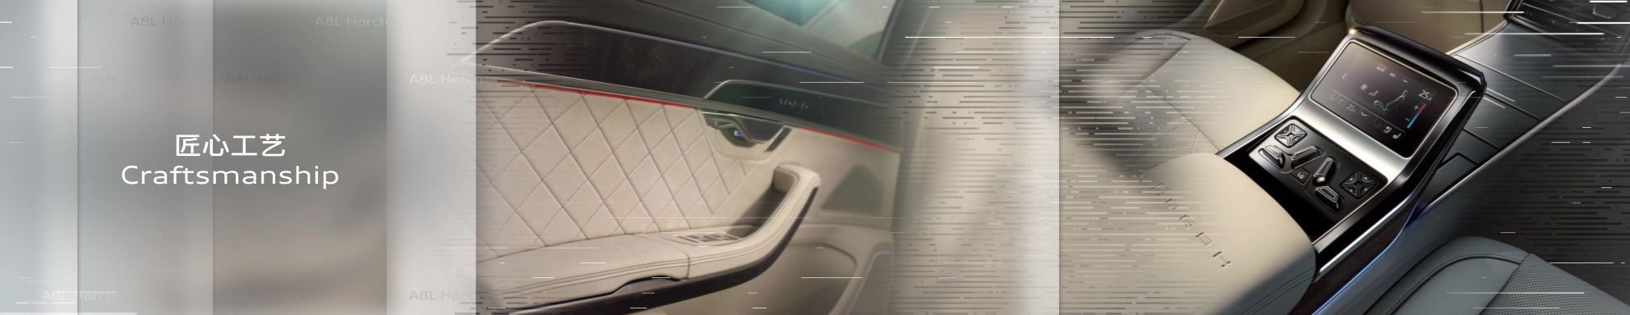
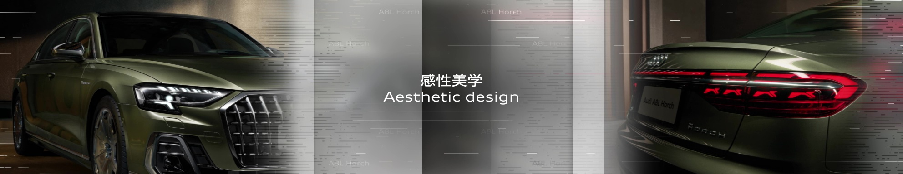
Media Show A8L Horch (45 sec)
Both Chinese and English subtitle replace:
现代精致体验
Modern sophisticated experience
English subtitle replace:
Emotional esthetic design

Slide 9
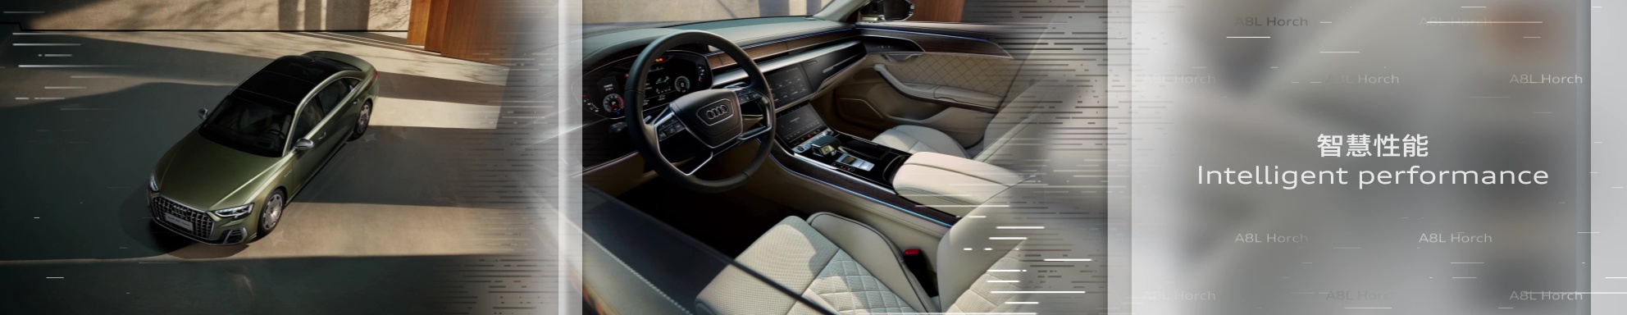

Media Show A8L Horch (45 sec)
Chinese subtitle replace:
智慧性能驾控

Slide 10


A8L Horch Entrance Loop (15-20 sec)
In Chinese :
All ‘全新奥迪A8L Horch’ should be replaced with‘全新奥迪A8L Horch创始人版‘
In English :
All ‘All New Audi A8L Horch’ should be replaced with ‘Audi A8L Horch Founder Edition’
Please Check all designs
Live PiP
Live PiP
This picture of rear space can be used still
but needs to be adjusted to make its space looks more extended
Entrance Jingle A8L Horch

Slide 11
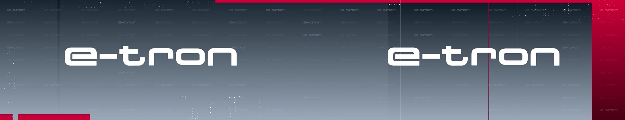
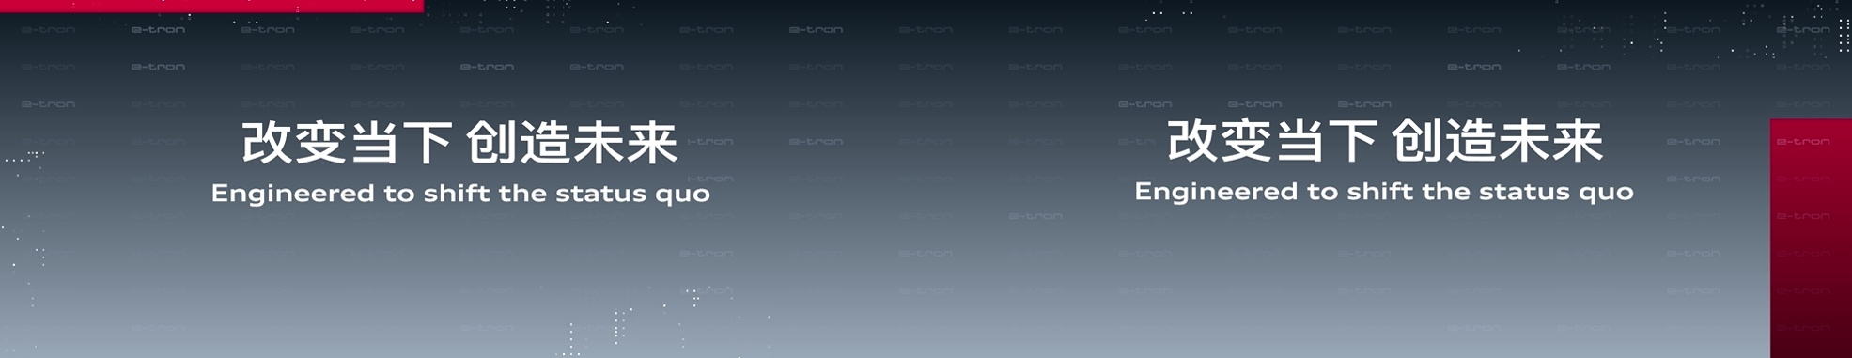
e-tron Product Show
’All in e-tron‘ as the title shows first.
Then, the four platforms – ‘MLB、 J1 、 PPE、 MEB’ are presented together.
subtitle replace: All in e-tron

Slide 12
e-tron Product Show
Subtitle addition:
MLB evo MEB J1 PPE
四大电动车型平台

Slide 13
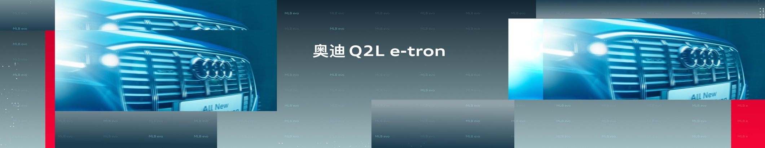
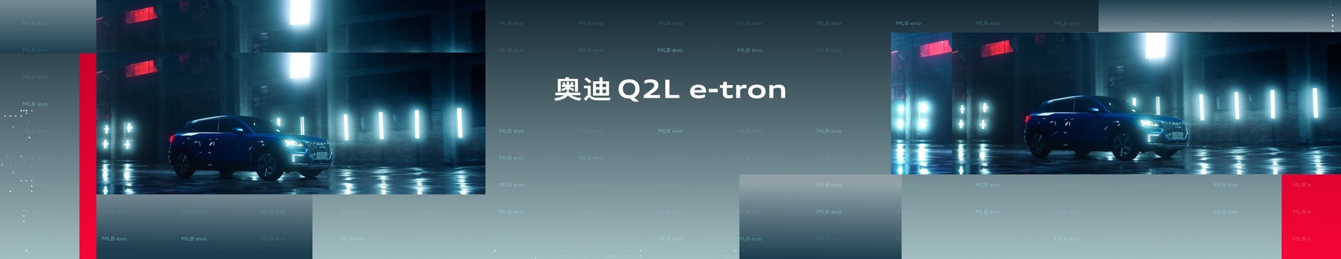
e-tron Product Show (1:25 min)

Slide 14
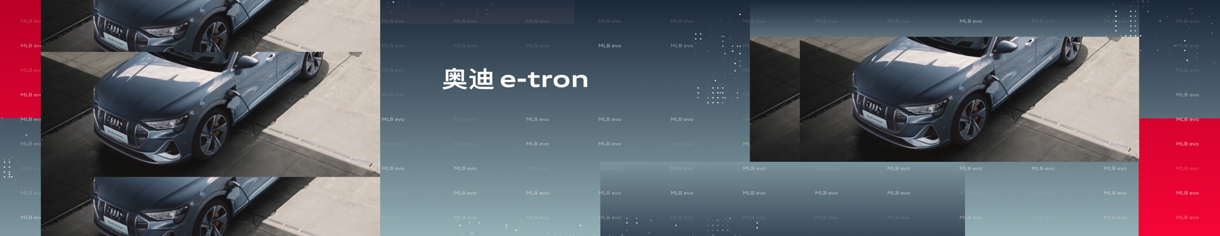
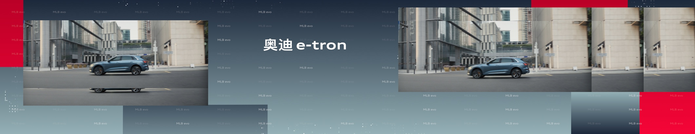
e-tron Product Show (1:25 min)

Slide 15
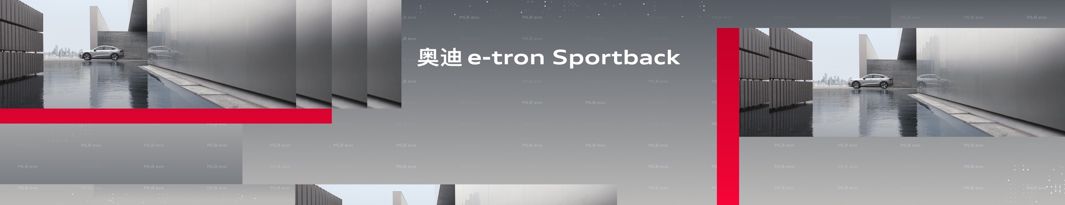
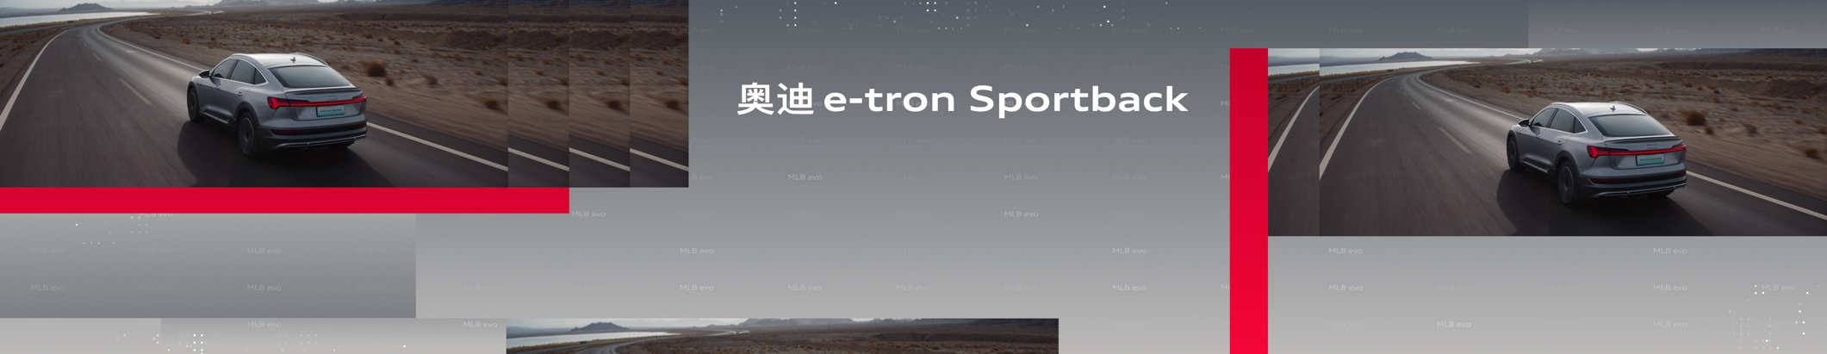
e-tron Product Show (1:25 min)

Slide 16
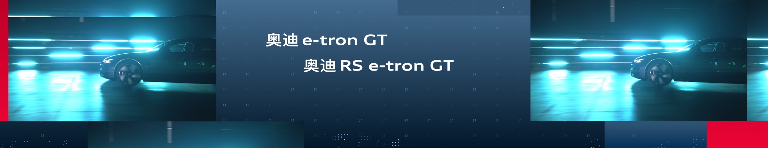
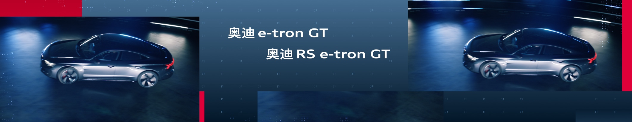
e-tron Product Show (1:25 min)

Slide 17
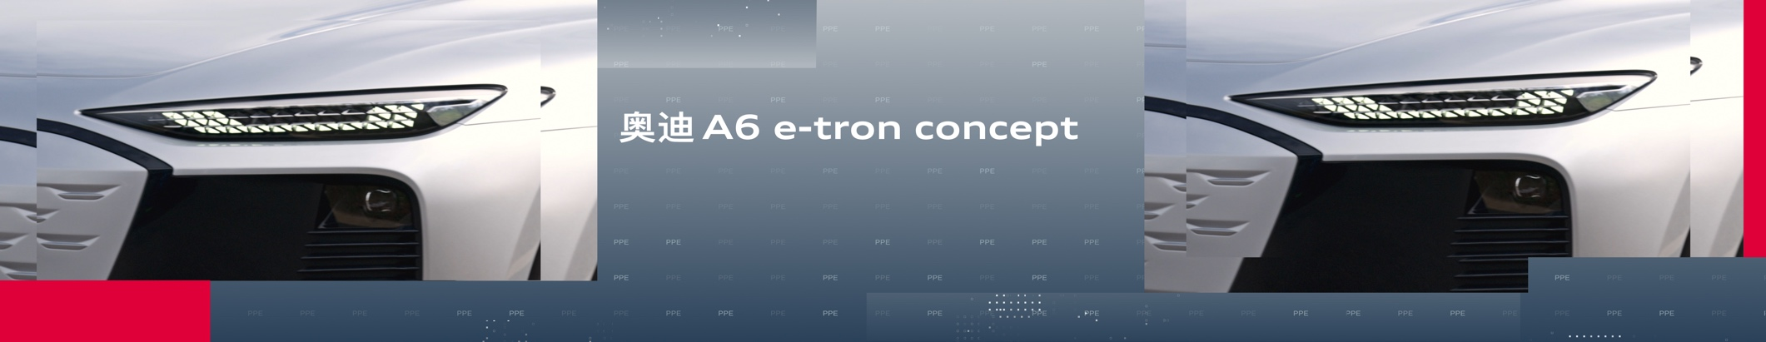
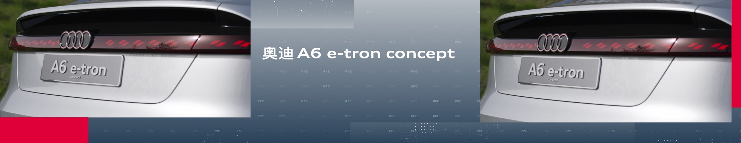
e-tron Product Show (1:25 min)

Slide 18
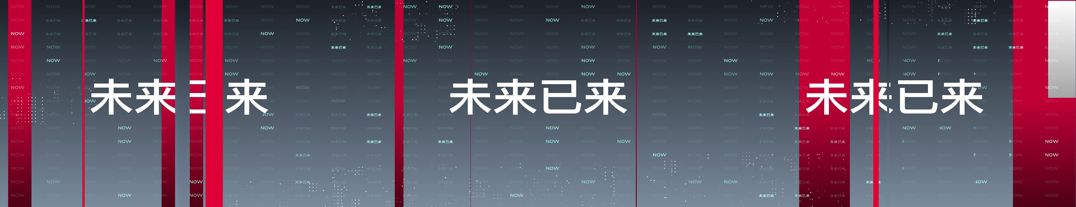
e-tron Product Show (1:25 min)
Subtitle addition:
奥迪e-tron家族新晋成员
New member of the e-tron family

Slide 19
e-tron Product Show
Subtitle addition:
MEB纯电平台首款国产奥迪车型
First domestic Audi model based on the PPE platform
Subtitle addition:
纯正德系豪华电动汽车
Pure German luxury electric car

Slide 20
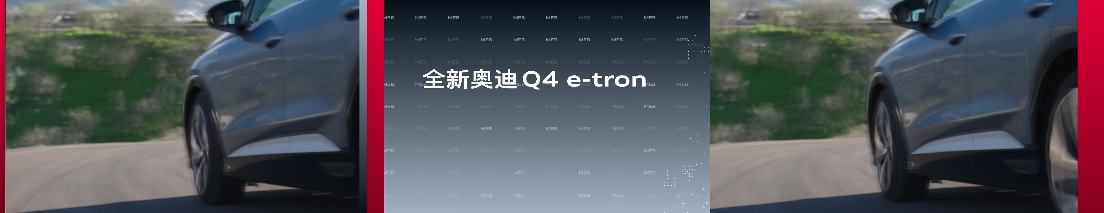
e-tron Product Show

Slide 21
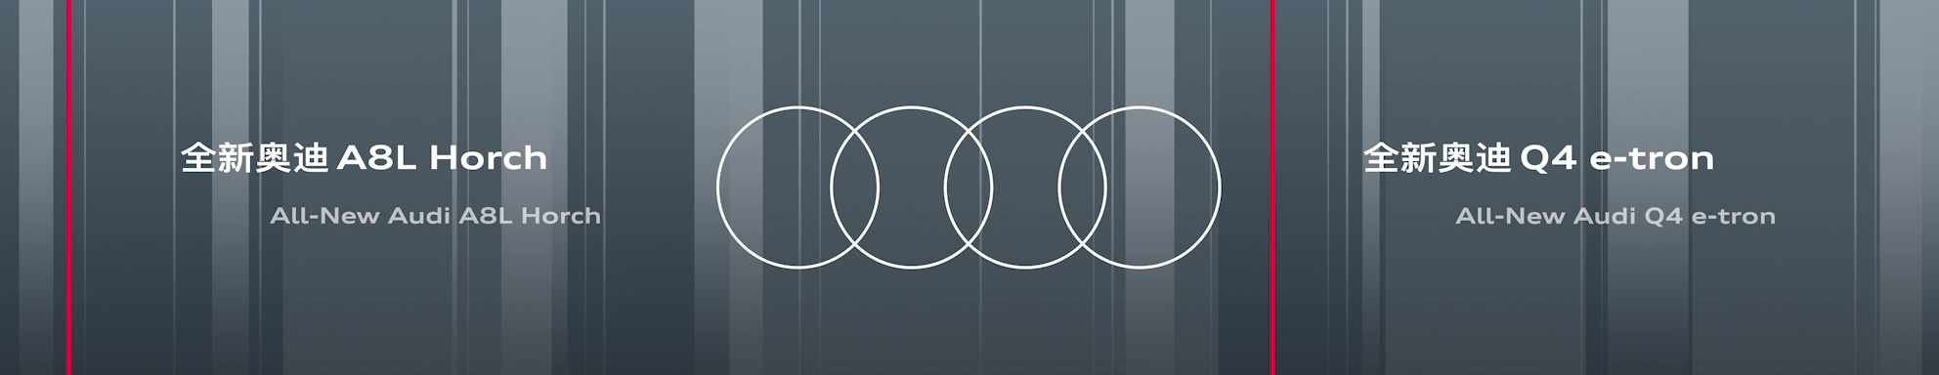
Aftershow Loop
‘All-New’ The middle link character needs to be removed.
The position of A8L Horch and Q4 e-tron needs to be exchanged

